Slide 1


KHARCHA SAATHI
EXPENSE
MANAGEMENT
SYSTEM
Group 5
Project Manager: Aadarsh Daseli
Business Analyst: Subarna Devkota
Lead Developer: Nayan Raj Khanal
Developer: Sajjan Dahal
Developer: Nishan Acharya

Slide 2
KHARCHA SAATHI
Introduction
provides a structured approach to managing personal expenses,
Helps to keep track of spending and identify areas where costs can be reduced.
Help individuals to monitor their expenses more closely, which can help them to stick to a budget and avoid overspending.
System can provide better visibility into spending patterns, which can help individuals to manage their finances more effectively, reducing financial stress and improving their overall financial wellbeing.
An Expense Management System can improve an individual's financial wellbeing by offering benefits such as increased financial control, savings, reduced stress related to finances, better budgeting, and improved financial awareness.

Slide 3
KHARCHA SAATHI
Sprint Planning
Sprint1 (Week 1-6)
Product Backlog(Week 1-3)
• Meeting with client
• Requirement gathering and analysis
• Conduct project kickoff meeting
Sprint Planning(Week 3-5)
• Develop wireframes for the UI/UX design
• Design UI/UX
• Conduct testing of the UI/UX design to ensure usability
Sprint Backlog(Week 5-6)
• Review and finalize UI/UX design for the first sprint
Sprint Review(Week 6)
• Get feedback from the stakeholders
Sprint 2(Week 6-12)
Sprint Planning (Week 6-10)
• Development of backend and frontend of product
• Testing of the application to ensure functionality
• Refine and optimize the code to improve performance
Sprint Backlog(Week 10-11)
• Review and finalize the final product
Sprint Review(Week 11 -12)
• Review the final product with stakeholdrs
Incremental
Sprint Retrospective (Week 12)

Slide 4
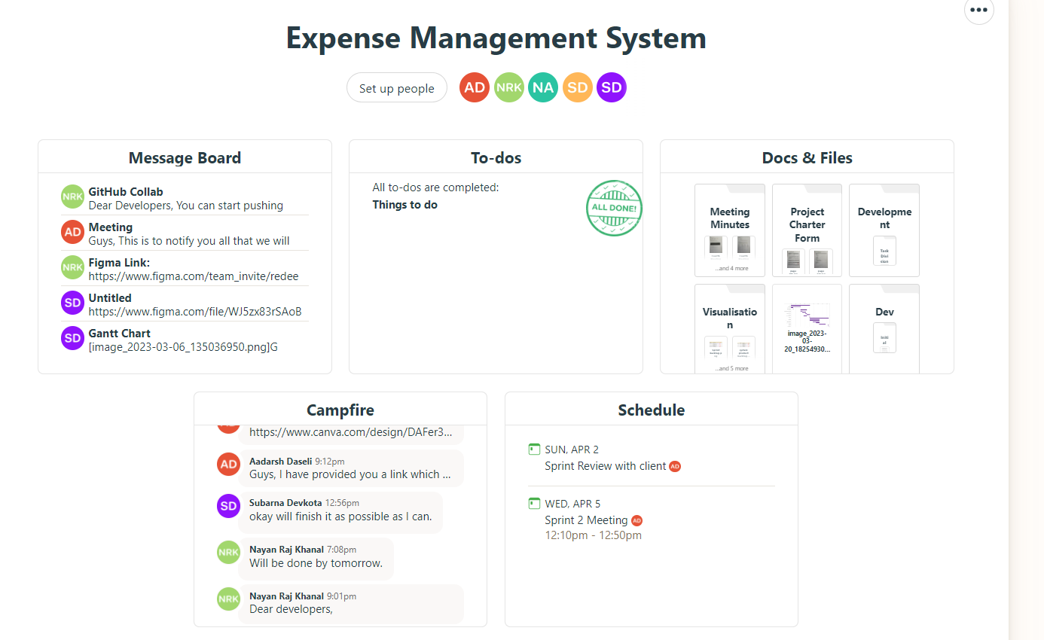
KHARCHA SAATHI
Basecamp

Slide 5
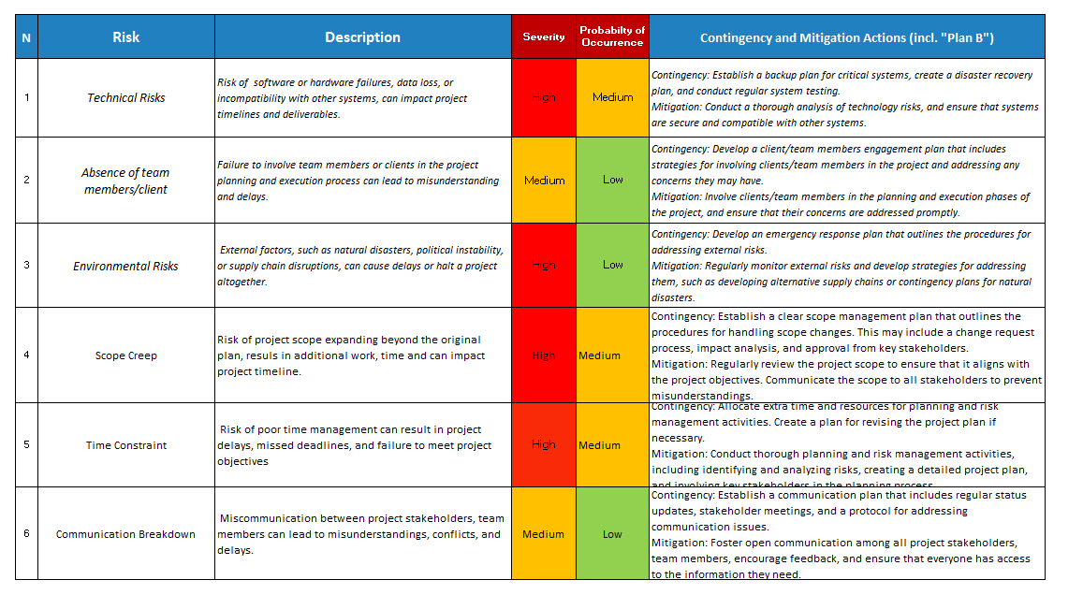
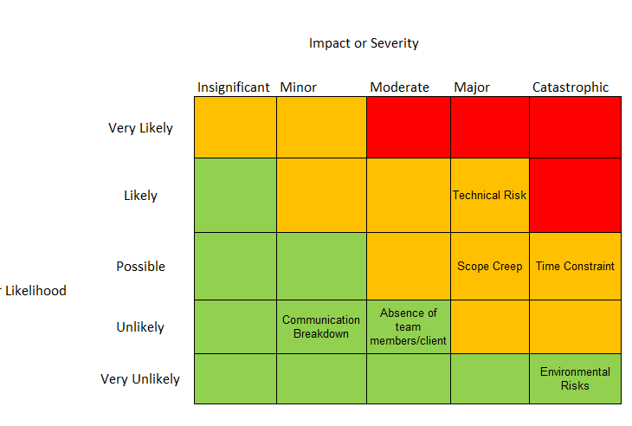
KHARCHA SAATHI
Risk Analysis

Slide 6
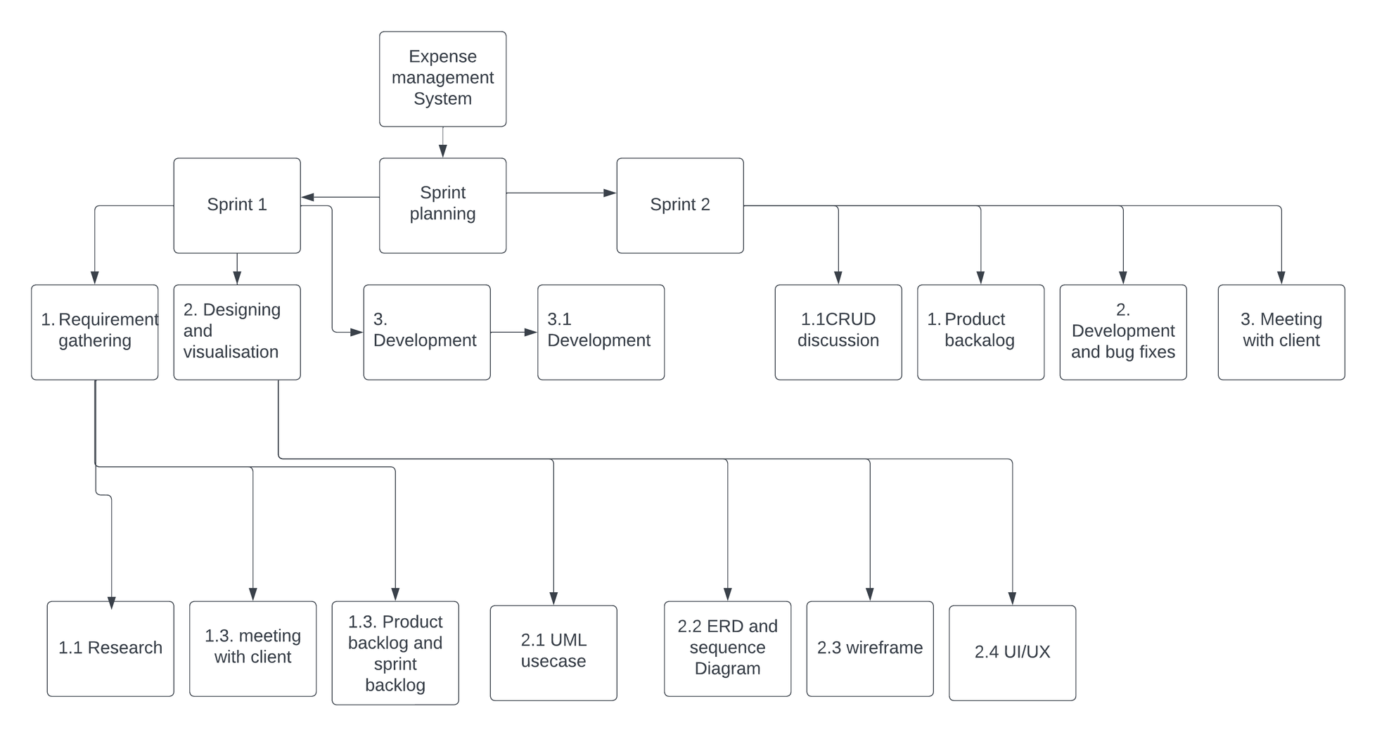
KHARCHA SAATHI
Back to Agenda Page
WBS

Slide 7
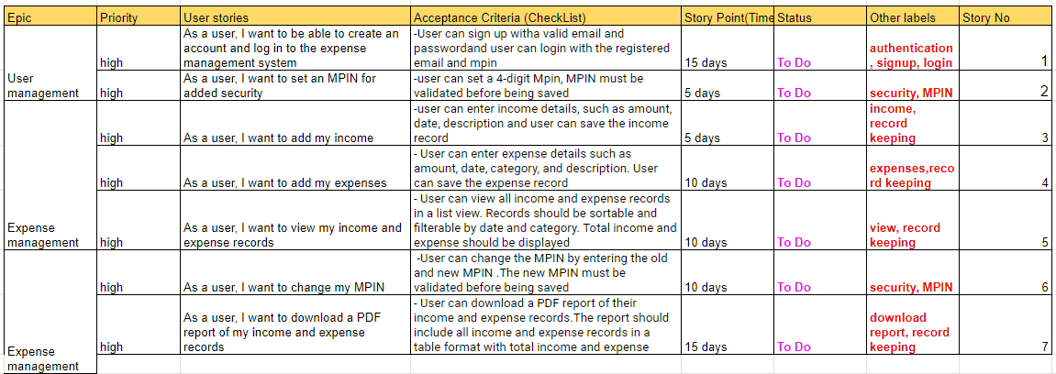
KHARCHA SAATHI
Product backlog

Slide 8
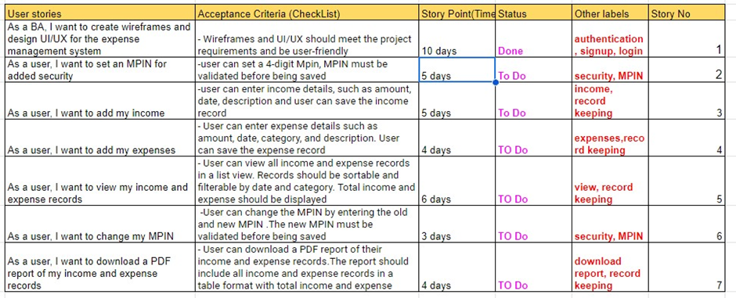
KHARCHA SAATHI
Sprint backlog

Slide 9
KHARCHA SAATHI
Functional Requirements
• User Login/Signup: Users will be able to create a new account or login to their existing account.
• MPIN setup: After logging in users can setup MPIN for their one-time setup.
• Currency selection: Users will be able to choose the currency to get started.
• Initial Balance: Users need to enter certain amount of money that will be the initial balance.
• Dashboard: Dashboard consist of information that tells the user if they’re at profit or loss with some sort of message and they’ll be able to see buttons to add income/expense.
• Add Income/expense: Users will be able to get into dashboard where they will havev the ability to add income and expense as per the need with proper date, amount, description.
• View Records: Users will be able to view the records monthly based on their added income and expense.
• Download Records: Users will be able to download their reports in PDF format.
• Menu: menu must consist of settings, budget goal(optional), Records.
• Settings: Users will be able to navigate through settings in which there are various settings such as changing MPIN, changing theme and navigating through help
• Change MPIN: Users will be able to change their MPIN as per their need.
• Theme Selection: Users will be able to change the theme of application.

Slide 10
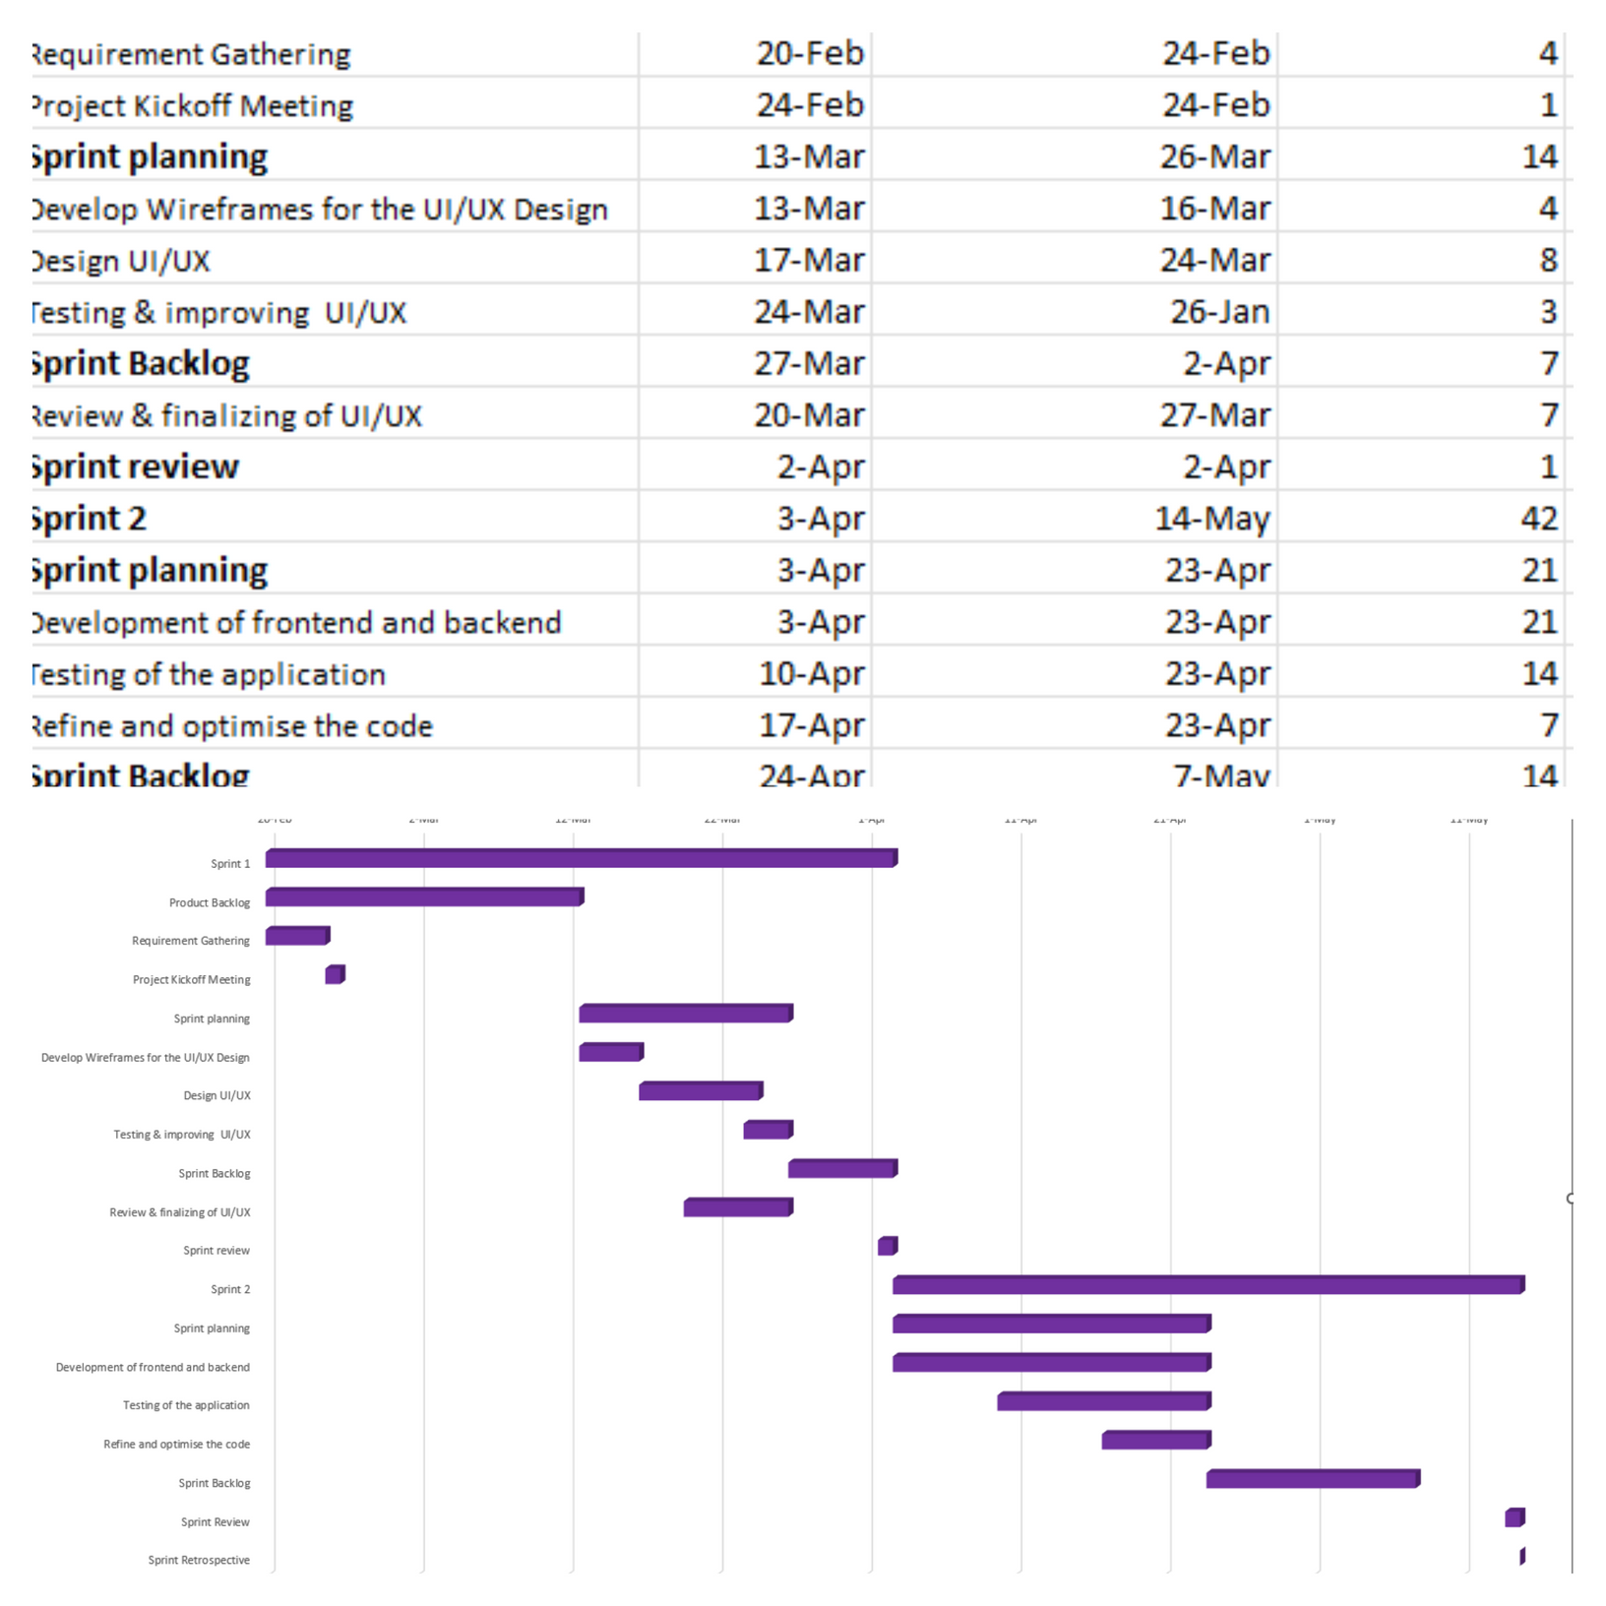
KHARCHA SAATHI
Back to Agenda Page
Gantt Chart

Slide 11
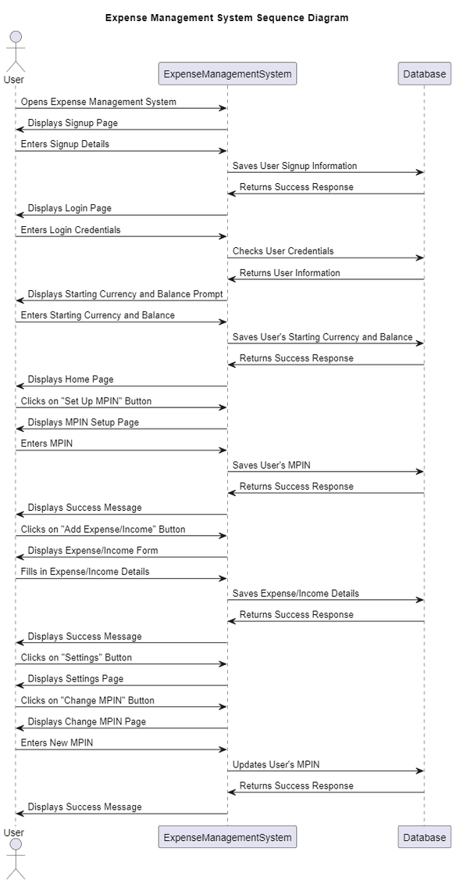
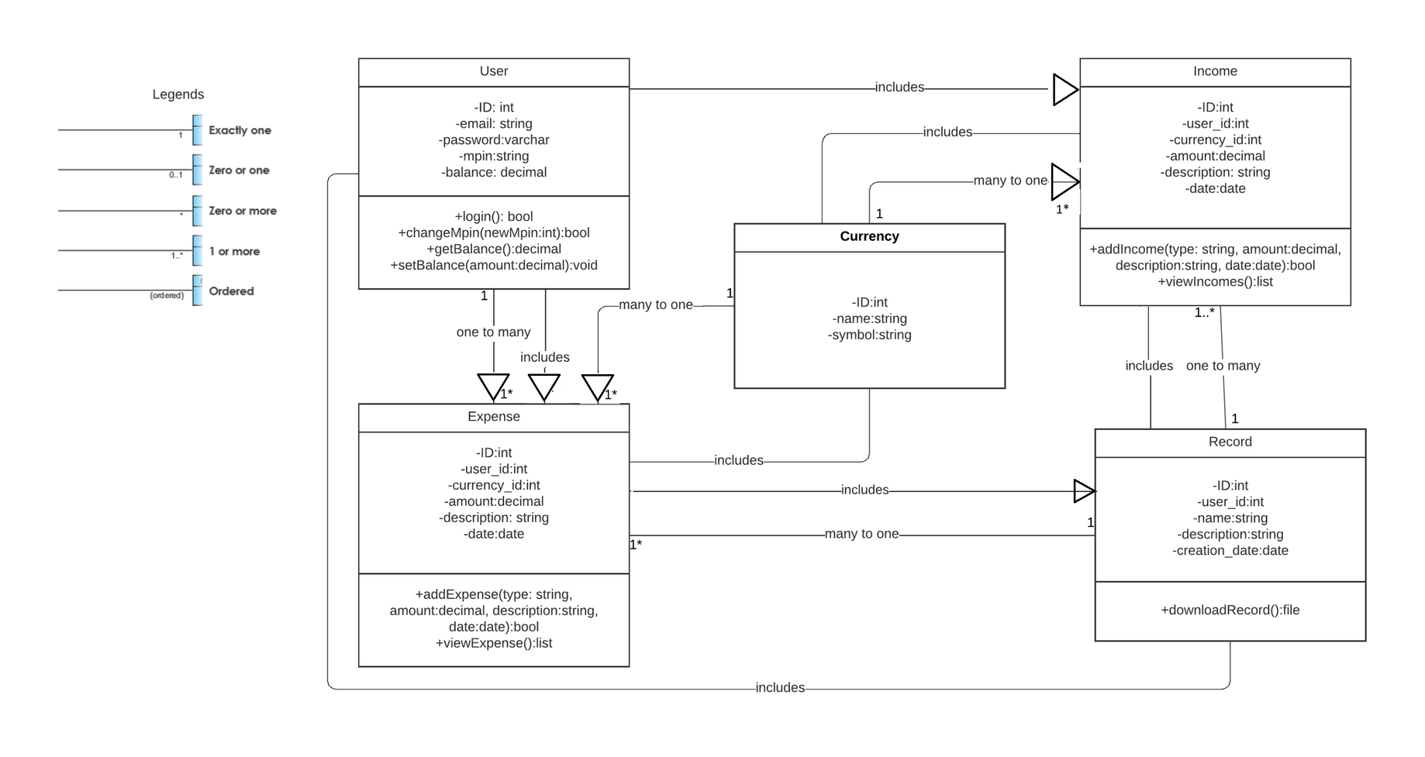
KHARCHA SAATHI
Sequence diagram
UML class

Slide 12
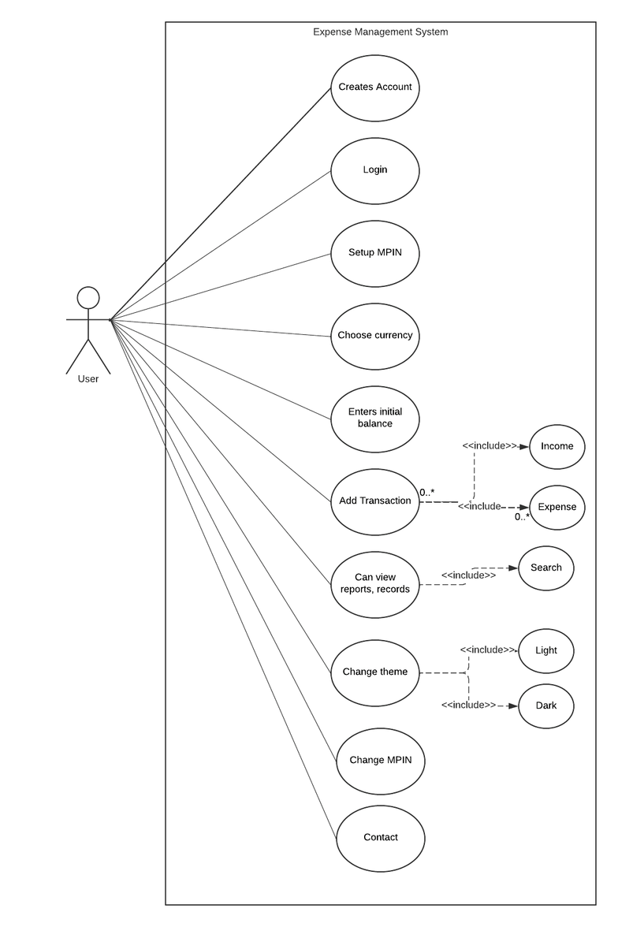
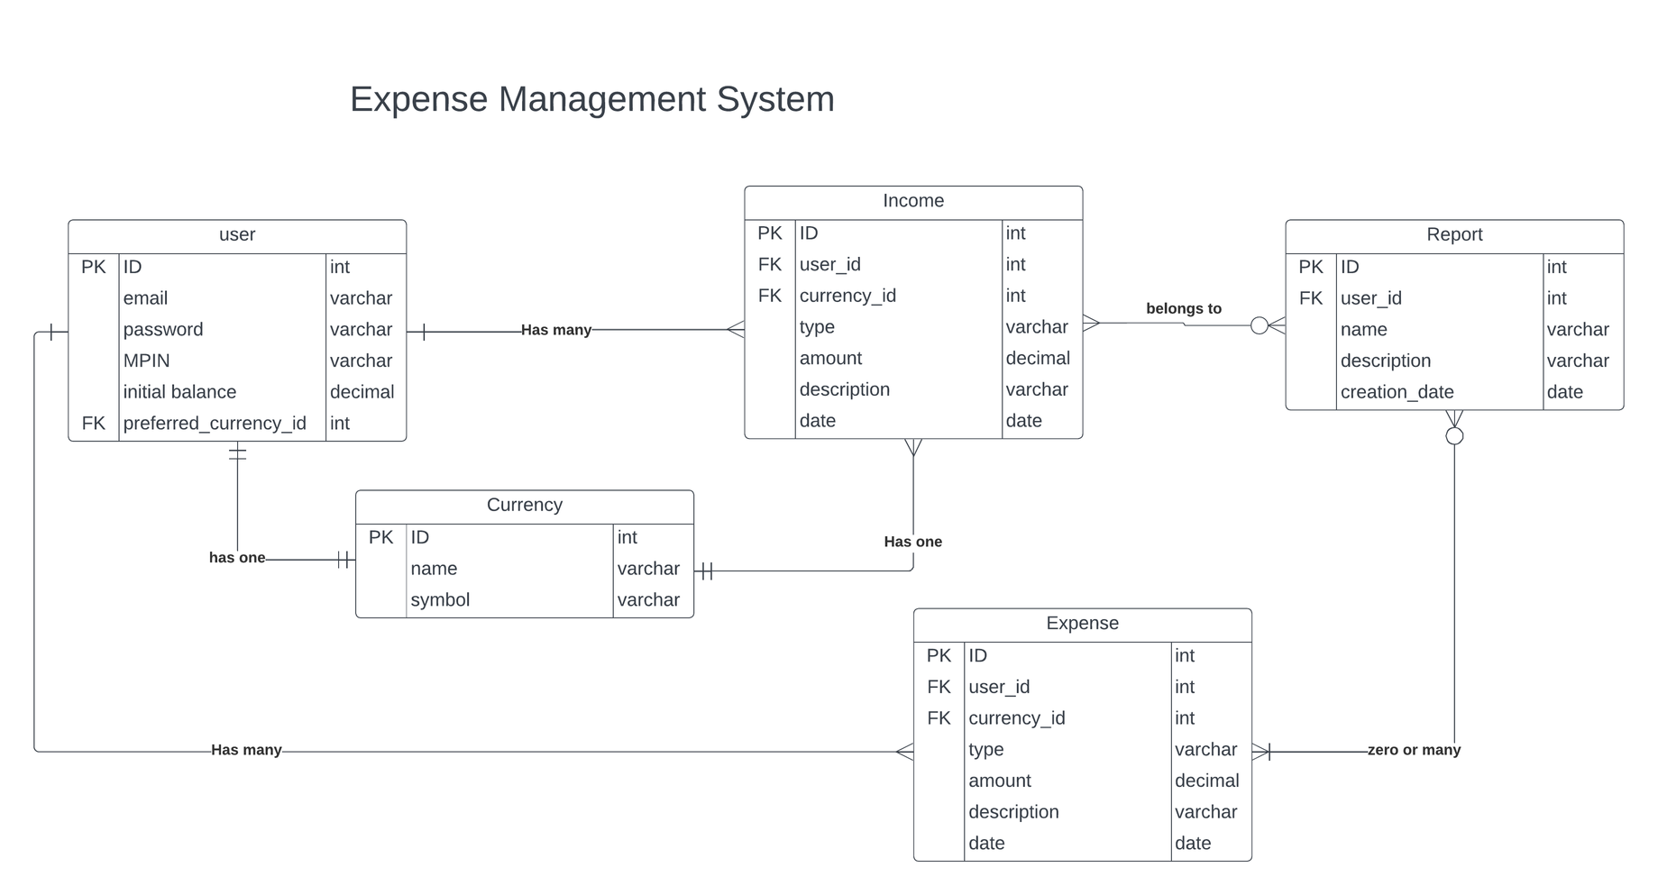
KHARCHA SAATHI
Usecase DIagram
ERD

Slide 13
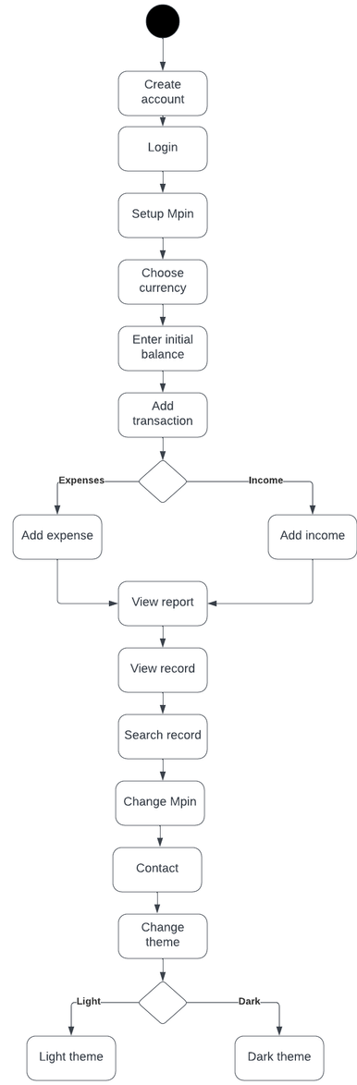
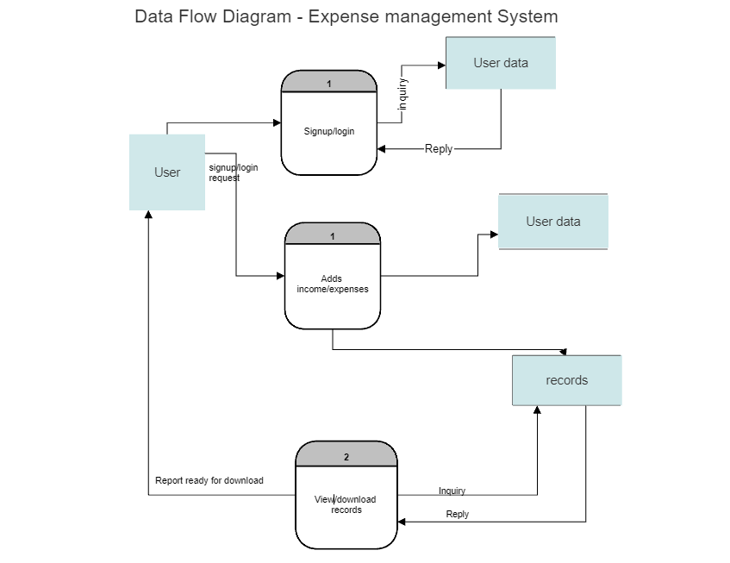
KHARCHA SAATHI
Data FLow DIagram
Activity DIagram

Slide 14
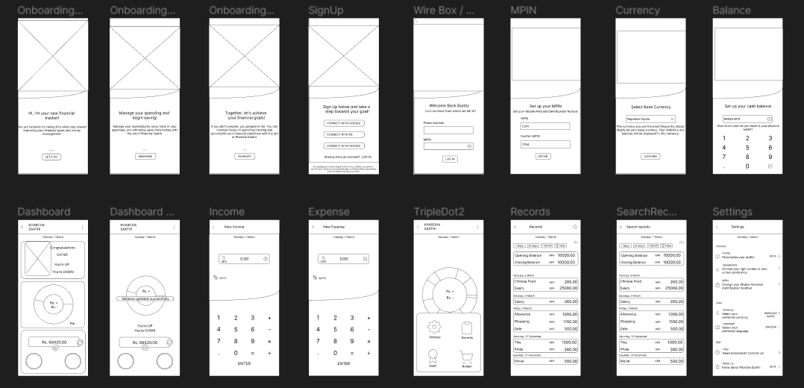
KHARCHA SAATHI
Wireframe

Slide 15
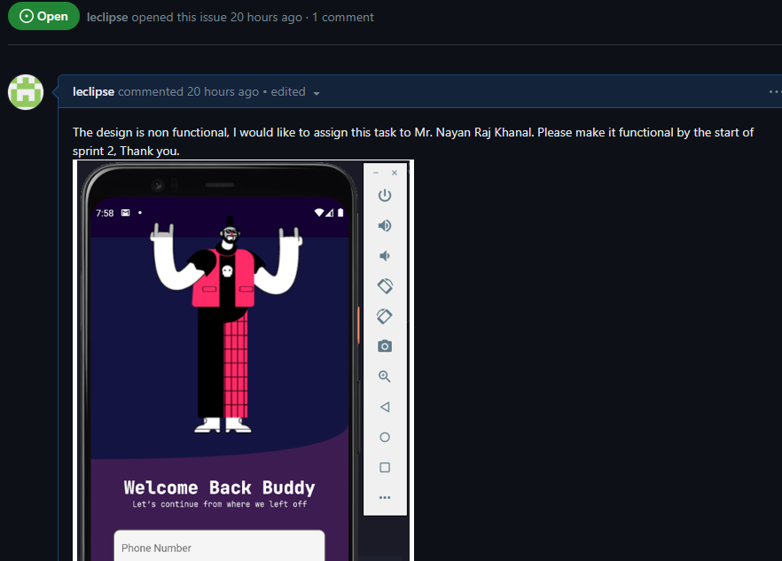
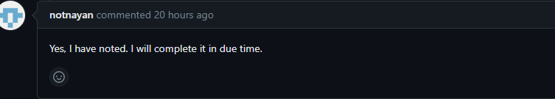
KHARCHA SAATHI
Issue Tracking

Slide 16
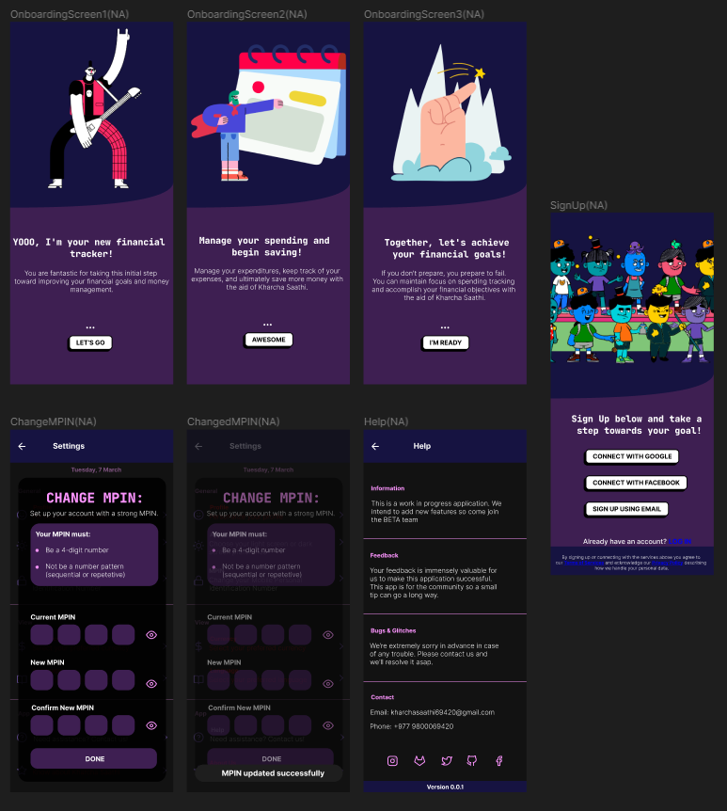
KHARCHA SAATHI
DESIGN:
Onboarding screen x3
Sign up page
Change MPIN
Help

Slide 17
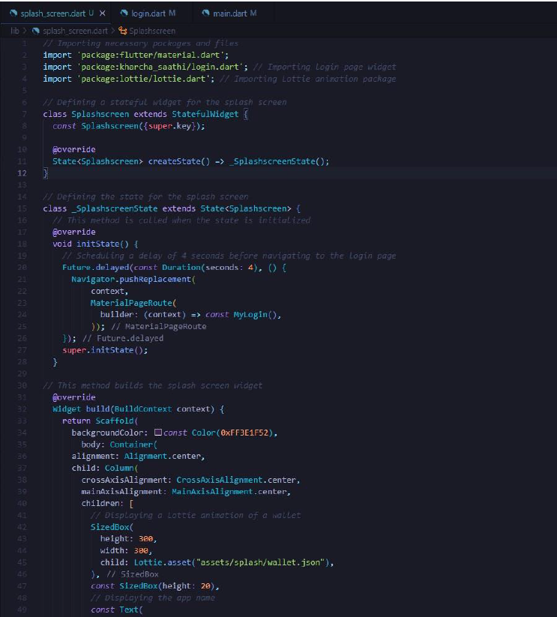
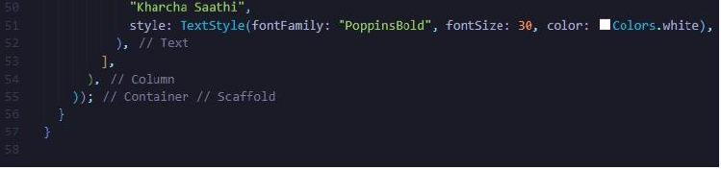
KHARCHA SAATHI
Splashscreen.dart

Slide 18
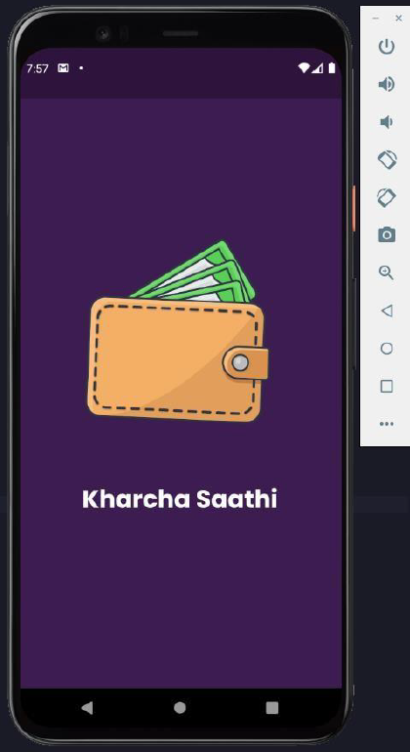
Written in Dart programming language
Stateful widget Mysplashsreen
Contains third-party animation from lottie and a label

Slide 19

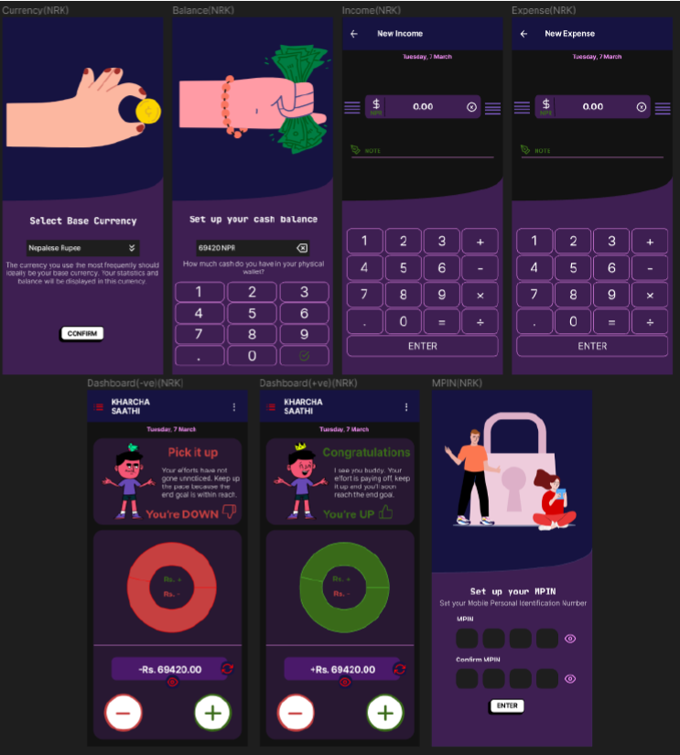
KHARCHA SAATHI
DESIGN:
Set up currency
Set up balance
Add expense, add income
Dashboard +ve, Dashboard -ve
Set up MPIN

Slide 20
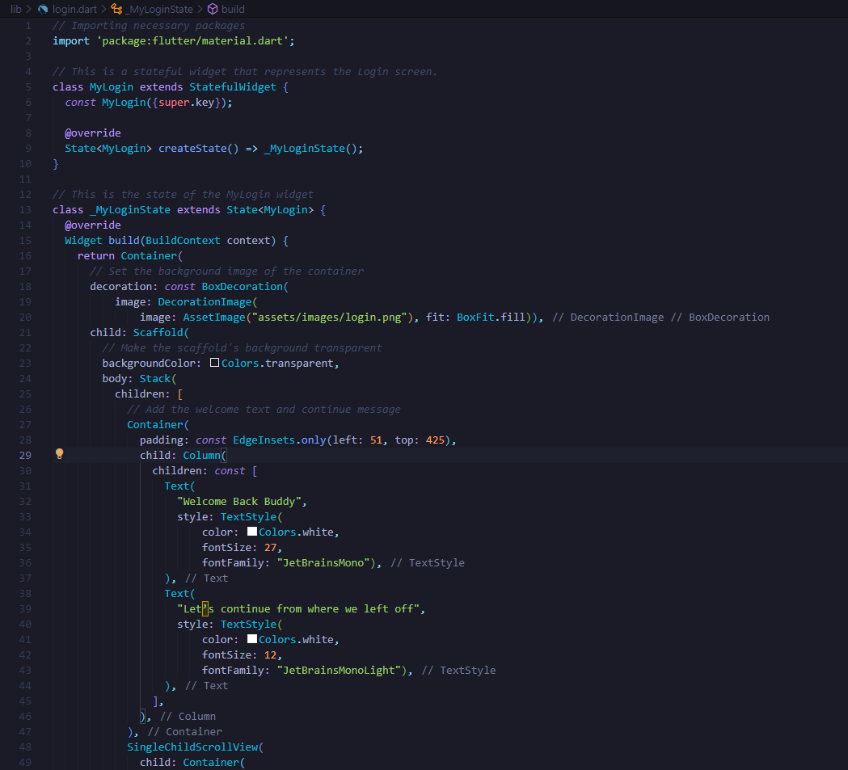
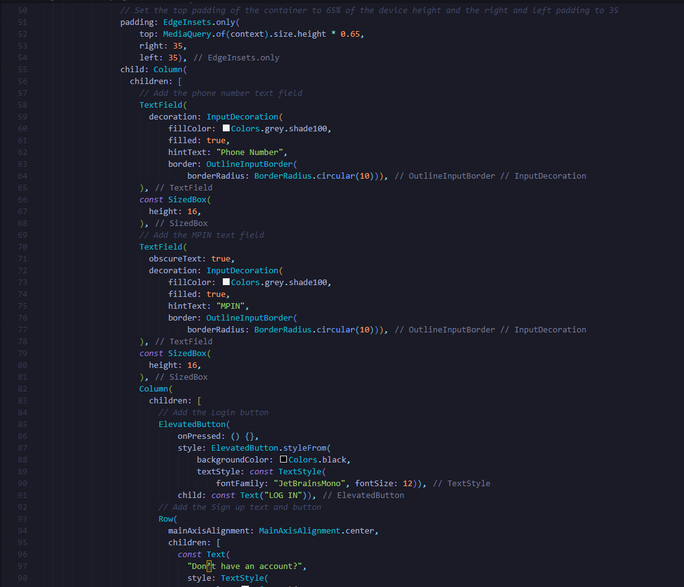
KHARCHA SAATHI
Login.dart

Slide 21
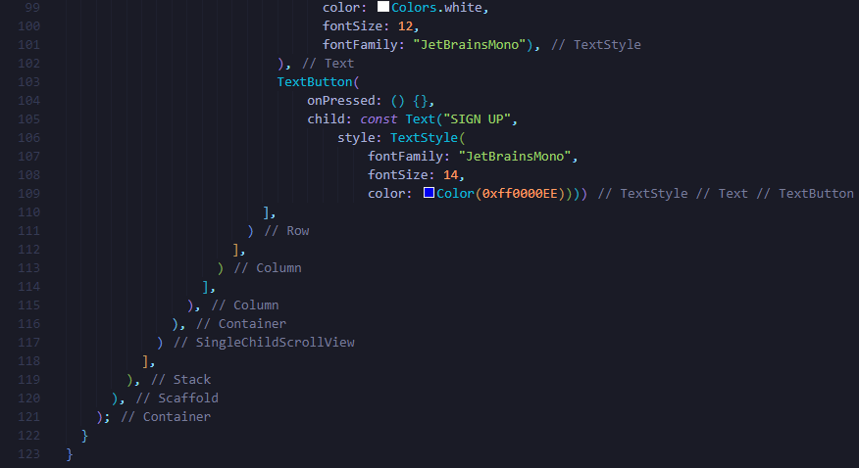
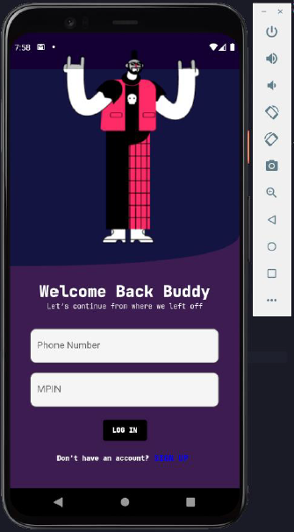

Written in Dart programming language
Stateful widget Mylogin
Contains Background image, two text fields, two buttons.

Slide 22
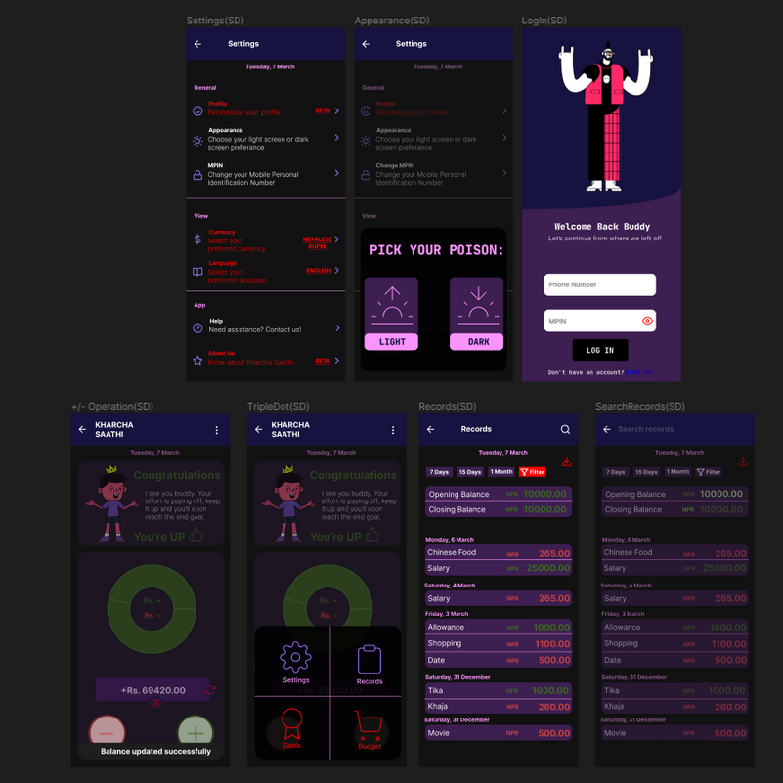
KHARCHA SAATHI
DESIGN:
Login Page
Settings, change theme
Records, search records
More

Slide 23
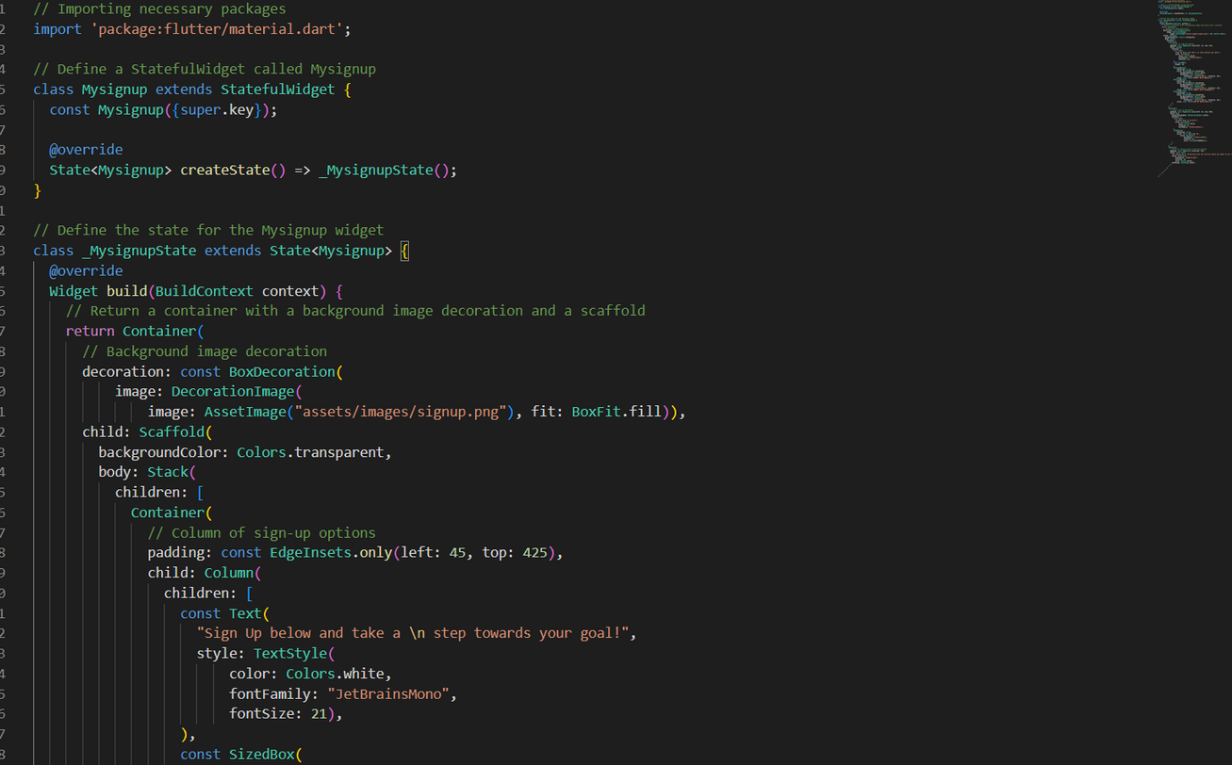
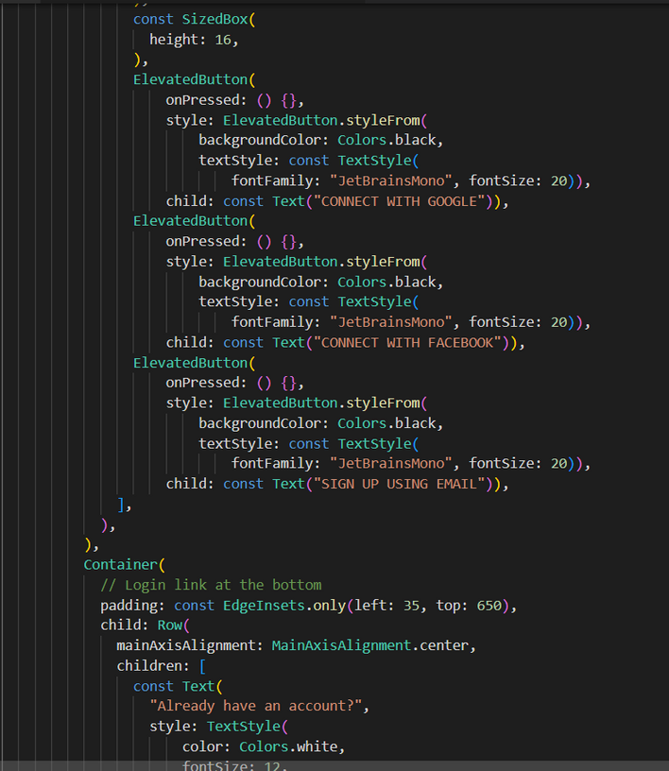
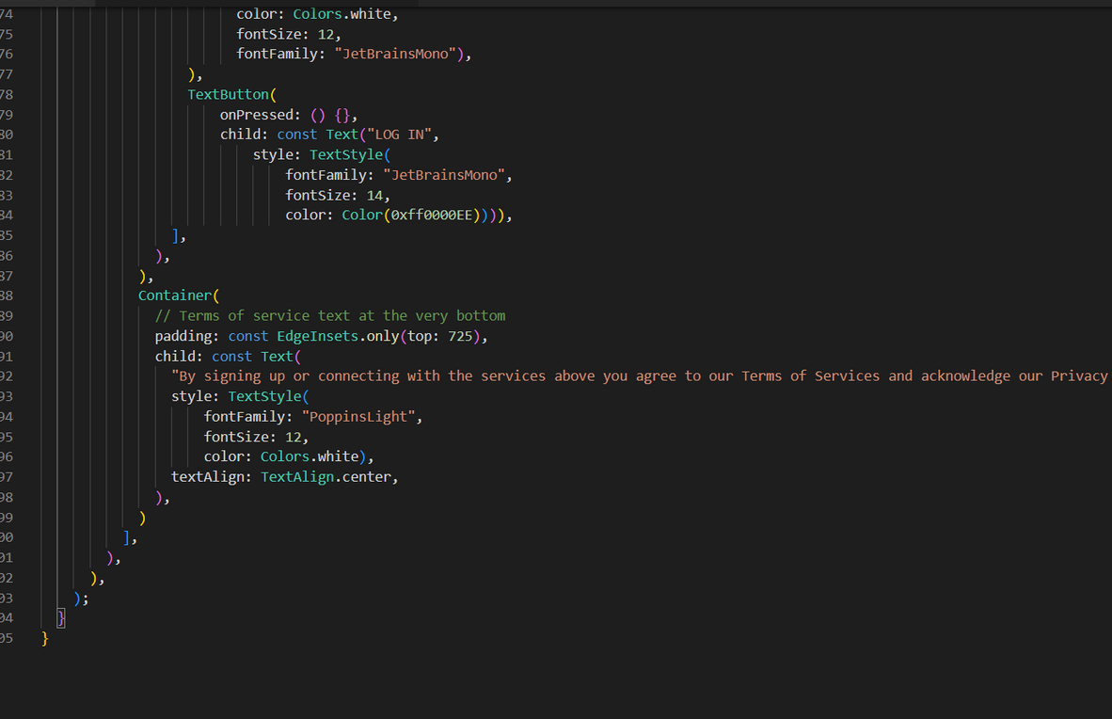
Signup.dart

Slide 24
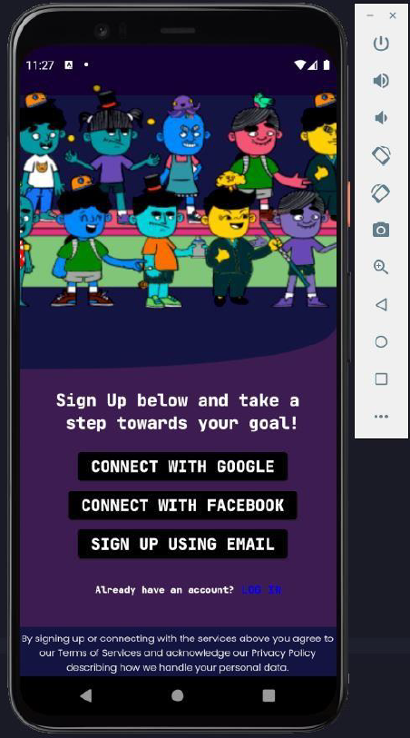
Written in Dart programming language
Stateful widget Mysignup
Contains a Background image, three elevated buttons and one text button

Slide 25
Thank You

